Slide 1
STLC
Prepared by
Subash B

Slide 2
STLC
Software Testing Life Cycle (STLC) is defined as a sequence of activities conducted to perform Software Testing.
Each of these stages have a definite Entry and Exit criteria; , Activities & Deliverables associated with it
Entry Criteria:
Entry Criteria gives the prerequisite items that must be completed before testing can begin.
Exit Criteria:
Exit Criteria defines the items that must be completed before testing can be concluded

Slide 3
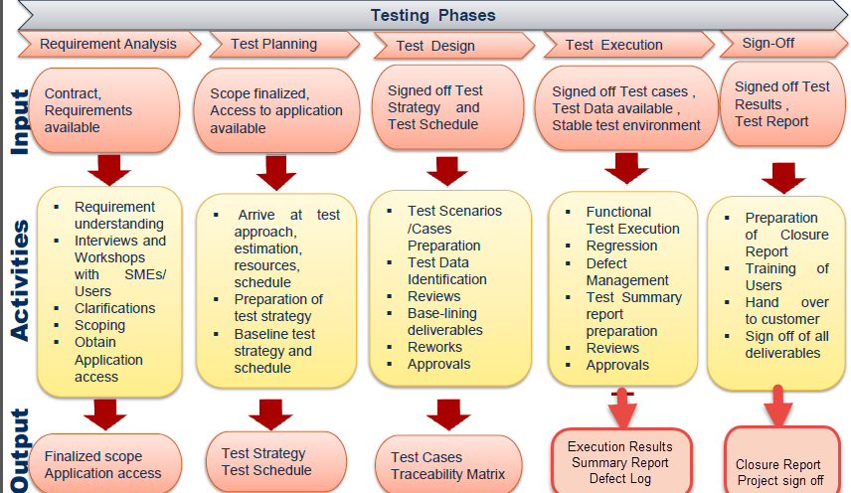

Slide 4
STLC
Requirement Analysis
Test Planning and Control
Test Analysis and Design
Test implementation and execution
Evaluating exit criteria and Reporting

Slide 5
Requirement Analysis
Identify types of tests to be performed.
Gather details about testing priorities and focus.
Identify test environment
Automation feasibility analysis
Entry Criteria: Contracts, BR Document
Exit Criteria: Finalized scope

Slide 6
Test Planning
Preparation of test plan/strategy document for various types of testing
Test tool selection
Test effort estimation
Resource planning.
Entry Criteria: Finalized scope
Exit Criteria: Test Strategy and test plan

Slide 7
Test Design
Create test cases, automation script
Review and baseline test cases and scripts
Create test data
Entry Criteria: Test Strategy and test plan
Exit Criteria: Test Suite, Test Case, Test Data, RTM

Slide 8
Test Execution
Execute tests as per plan
Document test results, and log defects for failed cases
Map defects to test cases in RTM
Retest the Defect fixes
Track the defects to closure
Entry Criteria: Test Suite, Test Case, Test Data, test environment
Exit Criteria: Execution Result, Defect Log

Slide 9
Test Closure
Evaluate cycle completion
Prepare test metrics.
The learning Document
Prepare Test closure report
Test result analysis
Entry Criteria: Execution Result, Defect Log
Exit Criteria: Closure Document

Slide 10
RTM
It confirms 100% test coverage
It highlights any requirements missing or document inconsistencies
It shows the overall defects or execution status with a focus on business requirements

